Slide 1
21st Century GLOBAL LeaderSHIP
A New Paradigm for
Leading Across Distance and Cultures
Ken Cochrum

Slide 2
The building of global teams is, indeed, the most important business challenge of the twenty-first century. Global success is now impossible without such teams.
- Michael Marquardt and Lisa Horvath, Global Teams

Slide 3
What is spiritual leadership?

Slide 4
Spiritual leadership is moving people
on to God’s agenda.
(Blackaby, Spiritual Leadership)
How do we lead people we can’t see
on to God’s agenda?
Notes:
How do we lead people we can’t see on to God’s agenda?

Slide 5
Exercise:
Think of one of the leaders you lead at distance. Someone in another city or country, not on your regular flight path or visitation schedule.
On average, how many ACTUAL HOURS of face-to-face (visit, conference) or live (skype, phone) conversation interaction time do you have per year?

Slide 6

6
Notes:
1. Our leadership challenge = shepherding and influencing those we do not regularly see. If a global leader has no more than 5 days per year of face-to-face time with his or her co-laborers in a multinational context, how can one appropriately serve, strengthen, inspire, align, equip, and coach those field leaders to live and lead well throughout the other 360 days?
Today’s social media tools – and growing acceptance of these by most of our cultures – provides an incredible opportunity to LEAD and LOVE WELL.

Slide 7
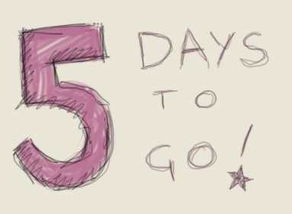


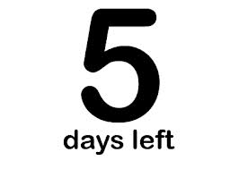
Local global copy.jpg
7

Slide 8
Local global copy.jpg
8

Slide 9
Local global copy.jpg
9

Slide 10
Local global copy.jpg
10
Notes:
Our leadership challenge = shepherding and influencing those we do not regularly see. If a global leader has no more than 5 days per year of face-to-face time with his or her co-laborers in a multinational context, how can one appropriately serve, strengthen, inspire, align, equip, and coach those field leaders to live and lead well throughout the other 360 days?

Slide 11
We are not the first generation to face the challenge of distance leadership.
Notes:
One of my goals today is to get you to RELAX.
There is a lot of tension in the scope of complexity of your role.
But… We are not the first generation of Christian leaders to face this challenge.

Slide 12
John: “though I have much to write to you, I would rather not use paper and ink. Instead I hope to come to you and talk face to face, so that our joy may be made complete.” 2 John 12
Paul: “For I want you to know how great a struggle I have for you and for those at Laodicea and for all who have not seen me face to face…” Colossians 2:1
Notes:
Consider Paul, and John. HEART. These first-century spiritual leaders felt the strain of what we call “mediated communication.” They had media – pen and ink – between them and their audience. But PRAISE GOD they used it! That’s how we have our Bible!

Slide 13

Local global copy.jpg
13
Notes:
1. To REPEAT: Our leadership challenge = shepherding and influencing those we do not regularly see. If a global leader has no more than 5 days per year of face-to-face time with his or her co-laborers in a multinational context, how can one appropriately serve, strengthen, inspire, align, equip, and coach those field leaders to live and lead well throughout the other 360 days?

Slide 14
Old Rules of Work
Work is a physical place
Work occurs between 8 a.m. and 5 p.m.
Employees, staff, or volunteers must be controlled
Work must be completed where the worker or formal leader is located
Relationships are limited to whom one can meet personally
New Rules of Work
Work is something you do
Work takes place between when it is assigned and when it is due
Employees, staff, or volunteers are responsible for results
Work (e.g., surgery, personal evangelism, follow up, mentoring, decision-making) can occur anywhere
One can interact online with almost anyone and develop deep relationships with people they have never met face-to-face
Source: Clemons and Kroth, Managing the Mobile Workforce (2011)

Slide 15


Who’s the leader?
Traditional leadership paradigms
“-Led” leadership paradigm
Notes:
Q: When you get to the BPMT time on Wednesday afternoon, how does ACCEPTED LEADERSHIP help you answer this question? Team leader and Task Leader?
We can illustrate the Old Paradigm (One leaders communicates to others) and New Paradigm (anyone can lead/initiate/upload/respond at anytime) like this.
THIS, BY THE WAY, REFLECTS THE HEART OF THE –LED PARADIGM. The structures now empower continuous communication by anyone, anytime. Over 1.2 Billion FB members, avg 135 friends, 50% post DAILY.
[[Tell Gateway Church FB Page Story – “Who’s in charge of this?”]]

Slide 16
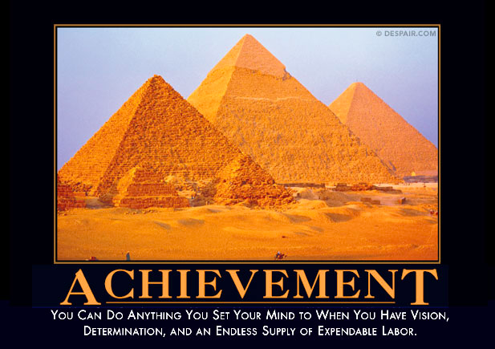

Slide 17
150 Years of Leadership Theory
Great man theory (leader as Hero)
Behavioral-trait theory
Transactional
Situational
Transformational
Post-heroic/Shared (Servant)
  Joint/distributed leadership
  Reciprocal influence
  Shared responsibility to initiate change
  All team members responsible for results
Notes:
Leader as Hero (authoritative, directive) – name another famous leader during the pyramids?
Behavioral-trait. What makes a great leader?
Transactional. Exchange. You do this, you get that.
Supportive/Situational – Leader as pyschological support, depends on circumstances and maturity
Transformational – leader as charismatic visionary who inspires and motivates
ALL IN COMMON: LEADER’s RESPONSIBILITY TO INITIATE CHANGE
Post-heroic/shared – joint/distributed, rec

Slide 18
The Global Leadership Challenge
Type of Team | Distance | Communication | Member Cultures | Leader Challenge
Conventional | Co-located | Face-to-face | Similar | High
Virtual | Scattered | Mediated | Similar or Different | Higher
Global | Widely Scattered | Mediated | Very Different | Very High
Source: Daft & Lane, The Leadership Experience (2008)
Notes:
“YOU ARE HERE”
We have asked you to do one of the most difficult jobs on the planet.

Slide 19
What makes an effective 21st century global leader? Two years of research …
How does God’s Word inform us?
What do 80 of CCC’s global leaders really want from their leaders?
What have the world’s
top global companies discovered?
Notes:
This research was the basis of my dissertation.

Slide 20
Discuss:
Think of a leader who led and loved you well over distance.
What are 2 or 3 leadership behaviors that you admire in that person?
Notes:
HANDOUT 1-page reference NOW

Slide 21
What 80 Top Leaders Really Want
Respect
Understanding and empathy
To be led by someone honest, authentic and competent
A clear challenge to contribute to the organization’s purpose
To share leadership
Notes:
Discuss: How did what you said support or disagree with these findings?
Ask any veteran “what do leaders really do?” and you’ll get a fairly predictable set of responses. You’ll probably hear that good leaders cast vision, set direction, inspire and motivate, align and communicate, coach and delegate, and listen well before making final decisions. There are dozens of “How To” leadership books published each year that repackage those skills in an attempt to help aspiring leaders lead well.
What if we asked a different question?
What if we asked veteran leaders, “How do you want to be led?”
During the past two years I had the opportunity to interact with 80 of my organization’s top global leaders who represent every area of the world. Most of these men and women have served for over 15 years in some type of distance leadership involving oversight of strategies in multiple countries. A large percentage have served outside their home nation for five years or longer. They help set longterm direction for our organization and are responsible for moving the mission forward in over 160 nations.
Here are five consistent answers that surfaced from my interviews:
1. Leaders want respect. Though respect is conferred differently in various cultures, people always appreciate graciousness, honor and appropriate deference to their experience. Mature leaders don’t demand respect, rather they exude a gravitas of character and humble confidence that reflects wisdom. Each one is worth listening to.
2. Leaders want understanding and empathy. These women and men have difficult jobs. They travel a lot. Their time is stretched thin. They are doing their best to find rhythm between work, home, church and a meaningful social life. Often they have few true peers that live nearby. Their vision typically outstrips their resources by a factor of 10 or 100. Remember these pressures in conversations where I’m evaluating their effectiveness or asking them to consider taking on a new project. Get on the same emotional page.
3. Leaders want to be led by someone honest, authentic and competent. People don’t expect their leaders to be perfect; they do expect us to be honest. They want to see us respond authentically as we share about our failures and our successes. They want to see us growing in competencies that help us do our jobs well, and thus improve the overall organization. Few, if any, mentioned that they wanted to have their direction set, their strategies formulated, or to be aligned or motivated with more words from leaders above them. If that’s not what people want from their leaders, why would we assume that we should be giving those we lead more of this type of leadership?
4. Leaders want a clear challenge to contribute to the organization’s purpose. That’s why most of them signed on. They want more clarity on the what’s of the mission, not the how’s. They’ll figure out how to get there. They want to be entrusted with more. What they need from us is an appropriate challenge, consistent support, and honest feedback on how they’re doing.
5. Leaders want to share leadership. I found this one fascinating. When our organization restructured two years ago, one of the five principles guiding our efforts was “shared leadership.” Many leaders initially resisted this, claiming that the essence of leadership (at least in their culture) was having someone in charge to make the final decisions. Yet people don’t want to be led that way. They want to voice their opinions. They want to shape overall direction. They long for the dynamic interaction among leader-followers that characterizes high performance teams. They want to be engaged in issues and decisions that they will ultimately own. They long to share leadership.
IN A WORD, SENIOR LEADERS WANT DIALOG.
How do you want to be led?

Slide 22
What 80 Top Leaders Really Want
DIALOGUE
Notes:
IN A WORD, SENIOR LEADERS WANT DIALOG.
How do you want to be led?

Slide 23
How Do I Do It?
A New Paradigm for 21st Century Global Leaders
Servant Leadership
Distance Leadership
Cross-cultural Leadership
Notes:
How do you do it?
Research-Grounded Paradigm
Biblical, 80 top leaders interviewed, Current practices
Our CCCi Leadership Framework is the foundation.
However, once you move to the scope and complexity of long-distance leadership, there are
Three elements that require a different level of perspective, mentality, life skills and LONG-RANGE INTENTIONAL DEVELOPMENT.

Slide 24
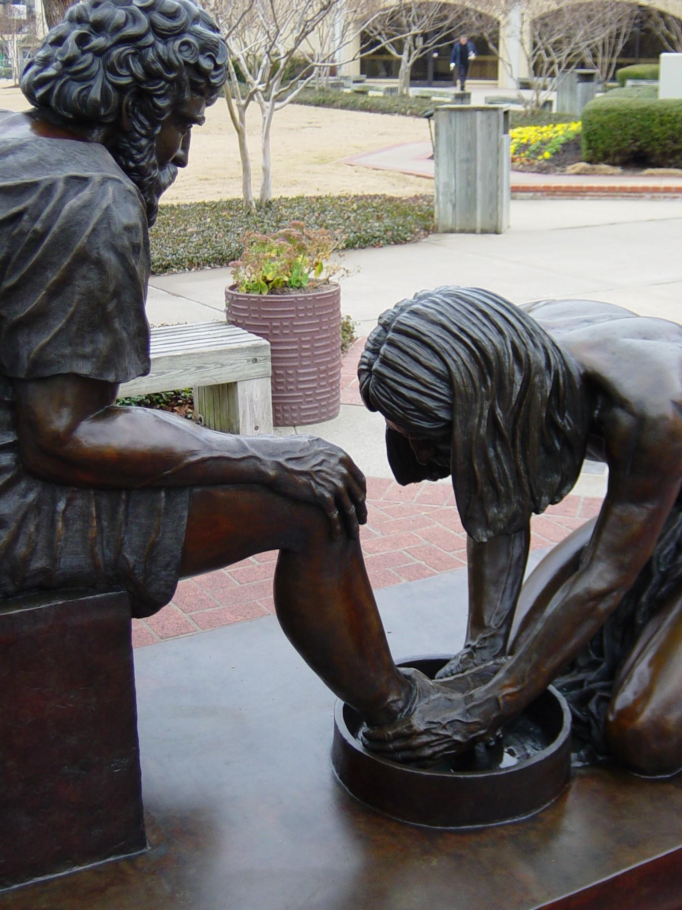
But it shall not be so
among you. But whoever would be great among you must be your servant, and whoever would be first among you must be
slave of all.
Mark 10:43-44
Leader as Hero?

Slide 25
A Servant Leader
Fully embraces God’s call to global level leadership of the organization
Increases in virtues of agapao love, humility, altruism, vision, trust, empowerment, and service
Listens in order to understand and empathize
Embraces suffering (pruning, pain, rejection, increased criticism, and misunderstanding)
Shares leadership; follows and leads equally well
Notes:
See HANDOUT.
DISCUSSION: Which are your two strongest areas? What do you feel might be your next area of intentional study and growth?

Slide 26
The Test of Servant Leadership
The servant-leader is servant first.
Do those served grow as persons? Do they, while being served, become healthier, wiser, freer, more autonomous, more likely themselves to become servants?
Source: Robert Greenleaf, Servant Leadership (1977)
Notes:
Tie back in to “Spiritual Leadership”:
This is God’s heart for people - Spiritual leadership is moving people
on to God’s agenda.
How does this test fit our –Led paradigm?

Slide 27
A Distance Leader
Enjoys a stable personal life
Leverages face-to-face and mediated communication to rapidly build trusting relationships
Asserts authority without being overbearing, inflexible or controlling; mentors with empathy
Is a global thinker; able to solve increasingly complex problems and offer flexibility in local implementation
Builds virtual teams that connect people, manage information, and execute action across borders
Notes:
DISCUSSION: Which is your strongest area?
What do you feel might be your next area of intentional study and growth?
Who is someone who can help you as a mentor or coach?

Slide 28
Q: How do I improve my virtual team meetings?
A: Visit www.onleadingwell.com. Search for ‘virtual’

Slide 29
Effective 21st Century Global Leaders understand that …
Culture eats Strategy
for breakfast
- Peter Drucker

Slide 30
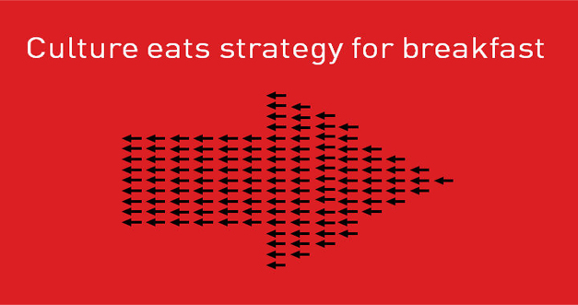

Slide 31
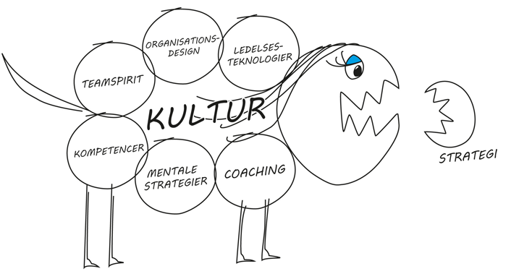
Notes:
Reflect – What does this diagram teach us?

Slide 32
Cross-Cultural Leadership
For God’s people to work together effectively, implicit assumptions about leadership need to be made explicit. They must be evaluated in light of sound social science research and biblical principles. The church in the North and South, the East and West acts out of unconscious and often confusing assumptions about leadership. We must appreciate the differences and challenge some of the misconceptions in order to work together as the worldwide body of Christ.
Jim Plueddemann, Leading Across Cultures: Effective Ministry in the Global Church (2009)
Notes:
Refer to June 2012 GLC – Jim Plueddemann’s two sessions with us. “Leading Across Cultures” as a resource.
What do you feel might be your next area of intentional study and growth?

Slide 33
Cross-Cultural Leader
Grows in self-awareness of personal cultural values and biases
Demonstrates cultural interest, sensitivity, and adaptability
Fosters mutuality and participation in all leadership venues
Understands cultural indices’ impact on strategy implementation and adjusts leadership appropriately
Notes:
Refer to June 2012 GLC – Jim Plueddemann’s two sessions with us. “Leading Across Cultures” as a resource.
What would be included in “All leadership venues?”
Teams – core and extended
Meetings, conferences
Task forces and design teams
On the ground interaction with national staff/volunteers
Email and virtual team facilitation
DISCUSSION: Which is your strongest area?
What do you feel might be your next area of intentional study and growth?

Slide 34
Portrait of a Universally Desirable
Global Leader
A man or woman who exhibits the highest levels of integrity,
has foresight and plans ahead,
and is able to build effective virtual teams to accomplish the institution’s mission.

Slide 35
Review:
A New Paradigm for 21st Century Global Leaders
Servant Leadership
Distance Leadership
Cross-cultural Leadership
Notes:
How do you do it?
Research-Grounded Paradigm
Biblical, 80 top leaders interviewed, Current practices

Slide 36
Review:
The Test of Servant Leadership
“The servant-leader is servant first.”
“Do those served grow as persons? Do they, while being served, become healthier, wiser, freer, more autonomous, more likely themselves to become servants?”
Source: Robert Greenleaf, Servant Leadership (1977)
Notes:
Tie back in to “Spiritual Leadership”:
This is God’s heart for people - Spiritual leadership is moving people
on to God’s agenda.

Slide 37
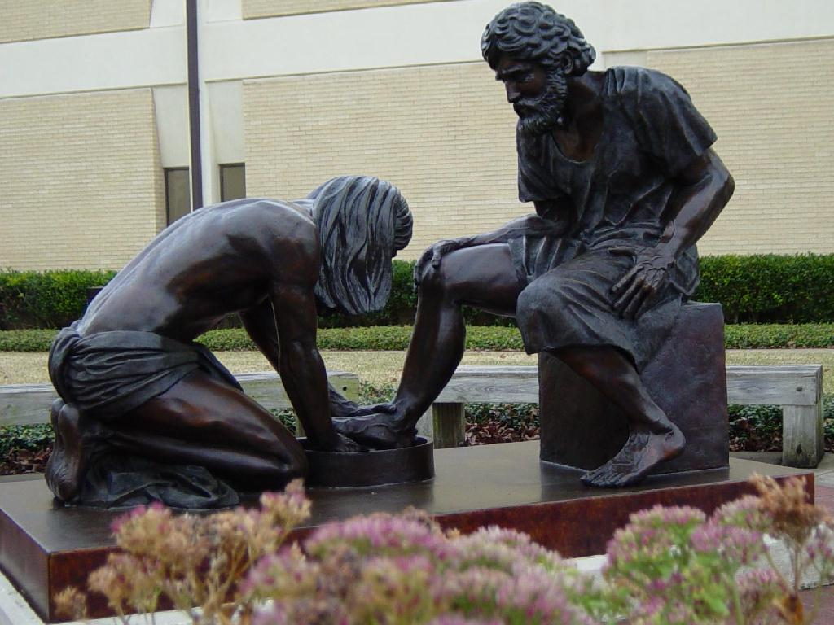
Notes:
For self-study: Investigate the leader self-references in the letters of the NT. Each of these leaders had a legitimate culturally-based authority claim. But, how did they refer to themselves? – ACT THIS OUT
Hi I’m John…best friend, adopted mother
Hi I’m Peter…the rock. Head of the Twelve.
Hi I’m Jude…half-brother of Jesus.
Hi I’m James…half-brother of Jesus AND head of the Jerusalem church.
Hi I’m Paul…
A SLAVE / BOND-SERVANT of Jesus Christ.

Slide 38

Want More?
Download “Close” pre-pub ebook here: www.onleadingwell.com/downloads
Print and ebook available at Amazon.com in November 2013.

